Slide 1

Python Course
Akhil Sathavaram

Slide 2
What is Python ?
Python is a programming language that is interpreted, object-oriented, and considered to be high-level too, released in 1991. People use Python for Competitive Programming, Web Development, and creating software. Due to its easiest syntax, it is recommended for beginners who are new to the software engineering field. Its demand is growing at a very rapid pace due to its vast use cases in Modern Technological fields like Data Science, Machine learning, and Automation Tasks.

Slide 3
Why Learn Python?
Easy to learn, read, and understand
Versatile and open-source
Wide usage
Supports libraries
Huge library
works on different platforms
Interpreted language

Slide 4
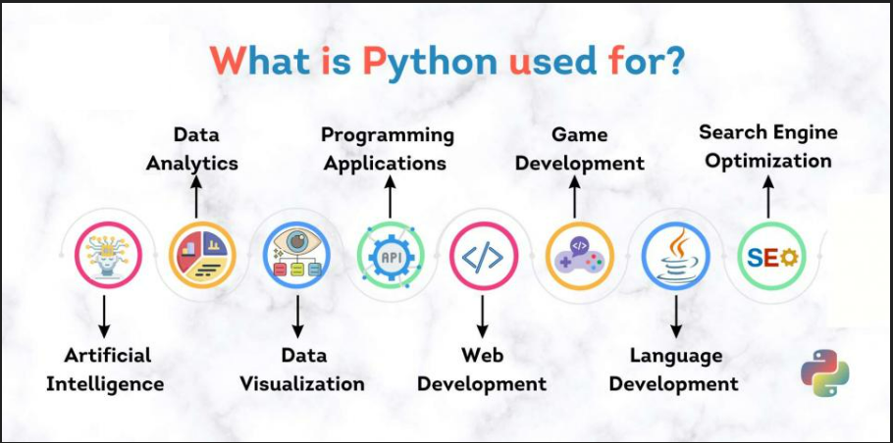

Slide 5
Week 1
Python setup and intro
Variables, datatypes, data types, keywords, operators, literals
Conditional statements (If , if else, nested if else)
Loops : for, while
Break, continue, pass
User inputs, comments
Week 2
Strings, list, tuple, sets, array
Functions, built-in functions, lambda
Files I/O, modules
Exception handling
Regex patterns
CSV/Excel I/O
To solidify candidate’s learning, daily assignments and coding challenges will be provided for homework

Slide 6
Week 3
Python OOPS concepts ***
Python collections
dictionary
Week 4
Multithreading
Basic libraries
Numpy, pandas, matplotlib
To solidify candidate’s learning, daily assignments and coding challenges will be provided for homework

Slide 7
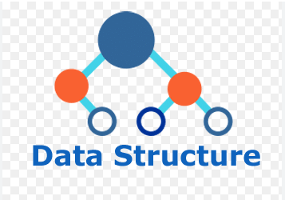
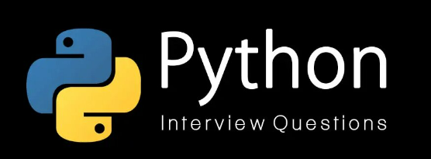
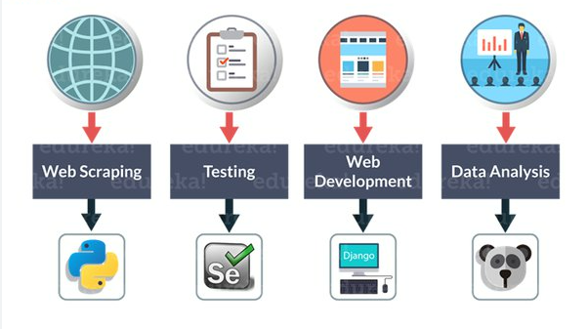
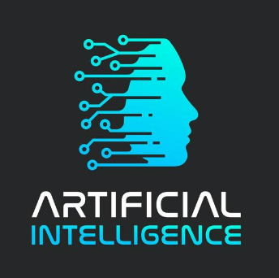
This course provides a solid foundation for the upcoming courses

